Slide 1


Slide 2

SPACED-REPETITION ALGORITHM IN LANGUAGE LEARNING APPS: A duolingo case study
Hi!
Aluu!
Salut!
Jambo!
Oi!
DATA400 – Spring 2024
Tai Nguyen

Slide 3

DATA SOURCE
Duolingo Research: https://research.duolingo.com/
Spaced-repetition dataset: https://dataverse.harvard.edu/dataset.xhtml?persistentId=doi:10.7910/DVN/N8XJME
Released under the Creative Commons Attribution-NonCommercial 4.0 International License (CC BY-NC 4.0).

Slide 4
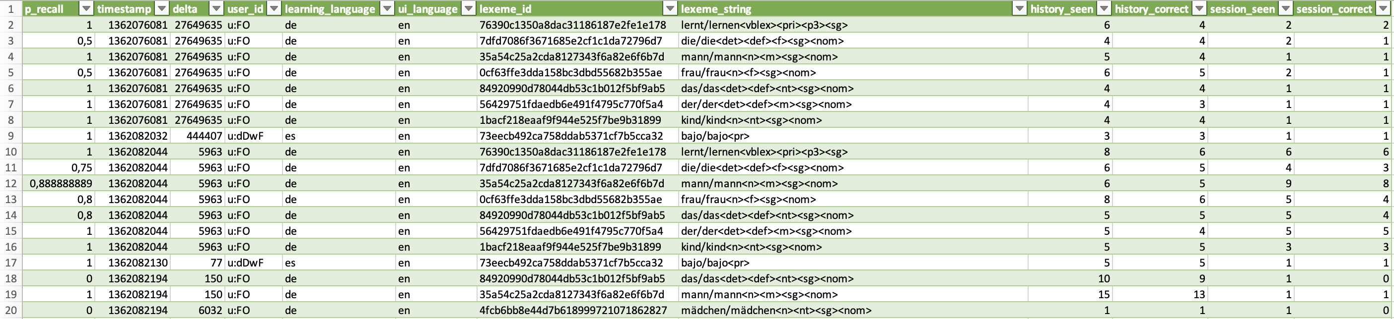
DATA INFO
Collection of 12,854,226 million user-word pairs (rows) and 12 variables (columns) for learners of several languages with a variety of language backgrounds.
Includes practice recall rates, lag times between practices, and other morpho-lexical metadata.
File size: 1,31 GB!

Slide 5
DATA INFO
12 variables:
p_recall - proportion of exercises from this lesson/practice where the word/lexeme was correctly recalled
timestamp - UNIX timestamp of the current lesson/practice
delta - time (in seconds) since the last lesson/practice that included this word/lexeme
user_id - student user ID who did the lesson/practice (anonymized)
learning_language - language being learned
ui_language - user interface language (presumably native to the student)
lexeme_id - system ID for the lexeme tag (i.e., word)
lexeme_string - lexeme tag
history_seen - total times user has seen the word/lexeme prior to this lesson/practice
history_correct - total times user has been correct for the word/lexeme prior to this lesson/practice
session_seen - times the user saw the word/lexeme during this lesson/practice
session_correct - times the user got the word/lexeme correct during this lesson/practice

Slide 6
RESEARCH GOALS
Hi!
¡Hola!
Assessing the effectiveness of spaced repetition algorithms in improving long-term retention of vocabulary in language learning apps
Oi!

Slide 7
DATA PRE-PROCESSING
nettoyage des données!
Converted delta time from seconds to minutes
Formatted timestamp from UNIX to DD/MM/YYYY
Fixed the lexeme_string problem

Slide 8
01
Exploratory Analysis
探索性分析

Slide 9
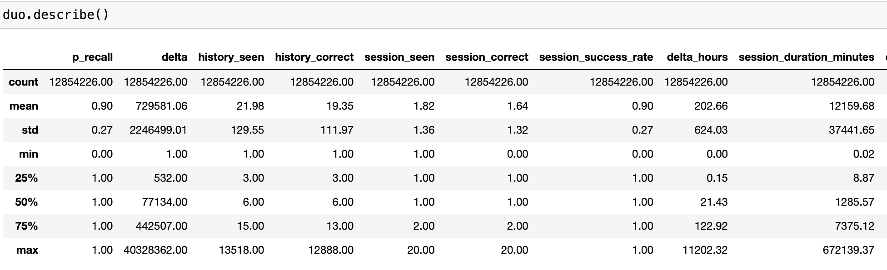
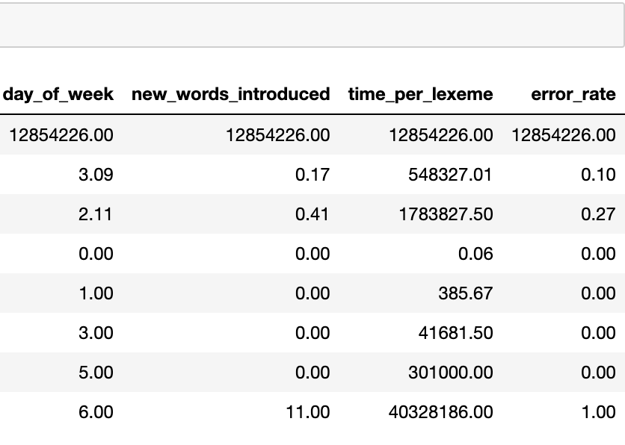
VARIABLE SUMMARY

Slide 10
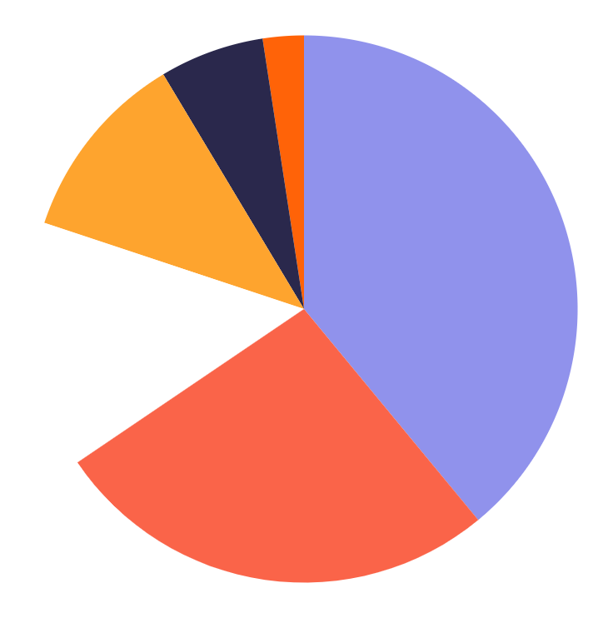
MOST LEARNED LANGUAGES
0.31 Million
5.01 Million
Portuguese
English
0.79 Million
3.41 Million
Italian
Spanish
1.45 Million
1.87 Million
German
French

Slide 11
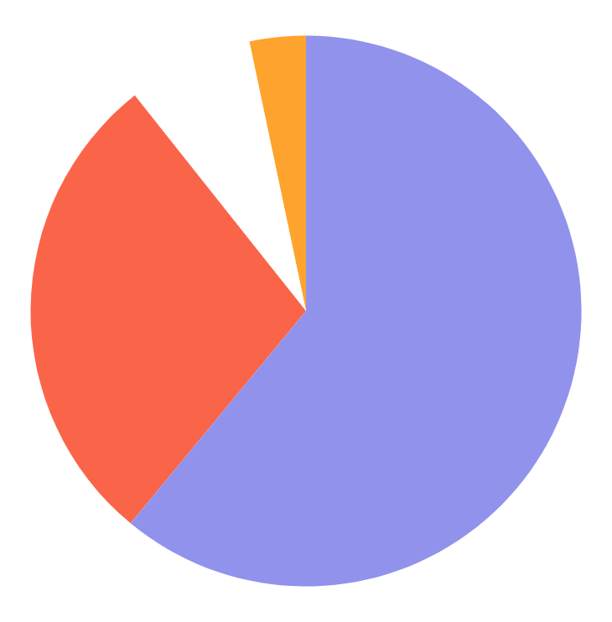
MOST USER-INTERFACE LANGUAGES
0.42 Million
7.84 Million
Italian
English
0.95 Million
3.64 Million
Portuguese
Spanish

Slide 12
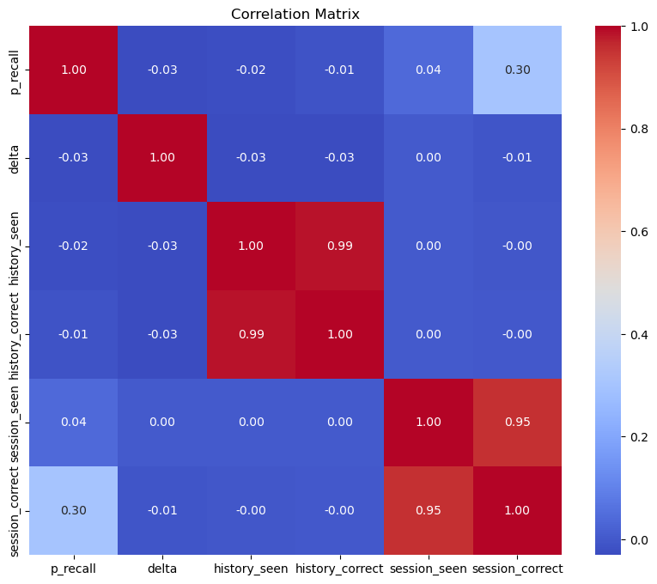
Coefficient Matrix: correlations between numerical variables

Slide 13
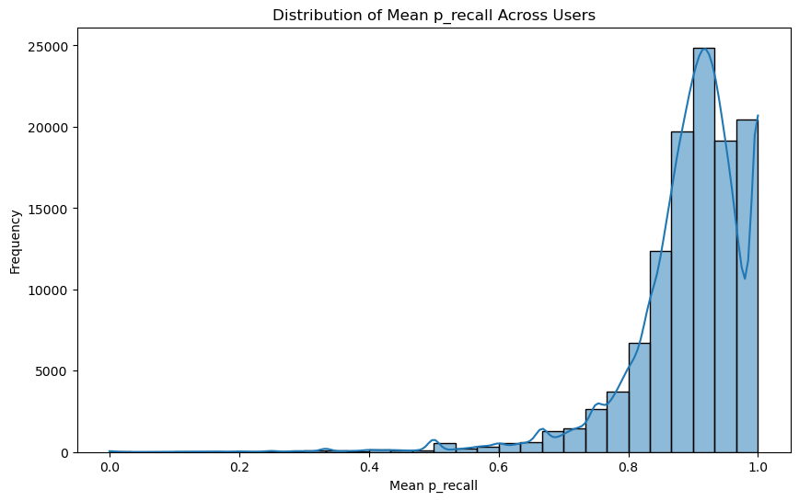
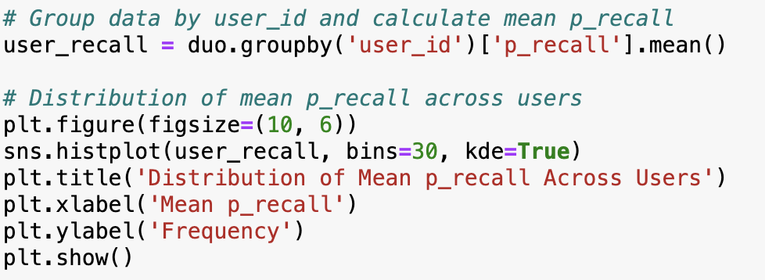
Distribution of Mean Recall Proportion across users

Slide 14
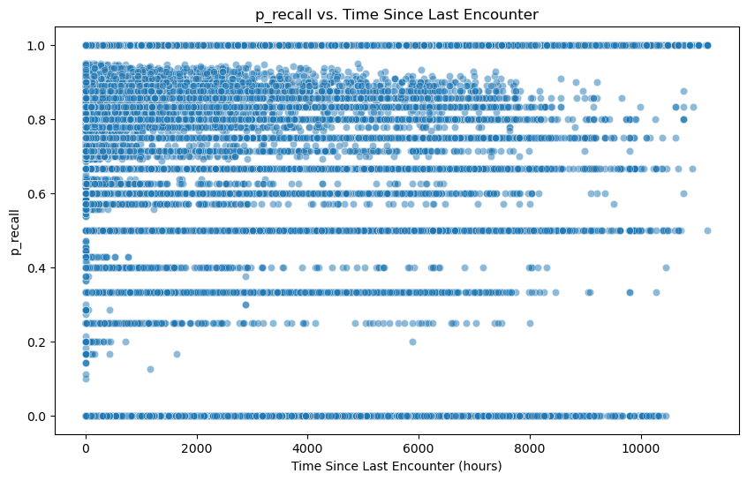
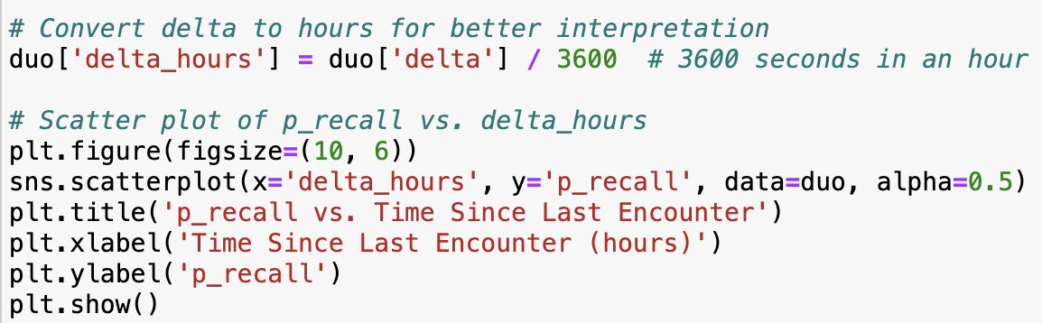
Time Decay : how recall performance decays over time since the last encounter.

Slide 15
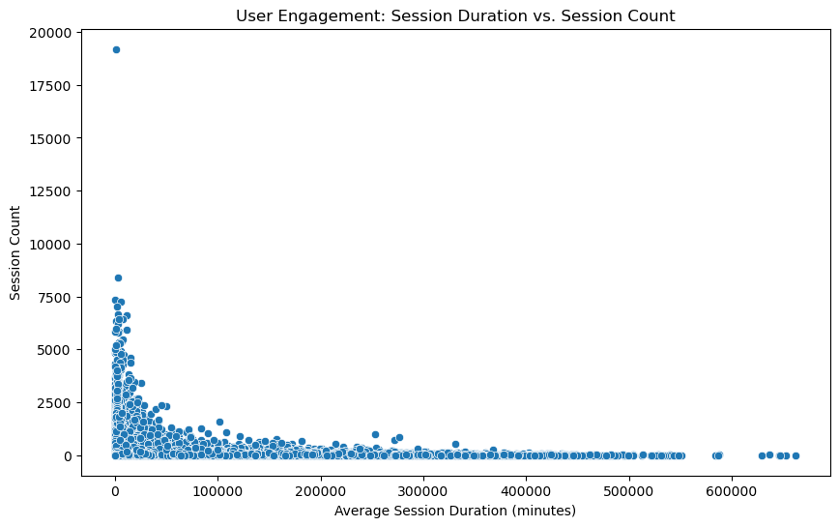
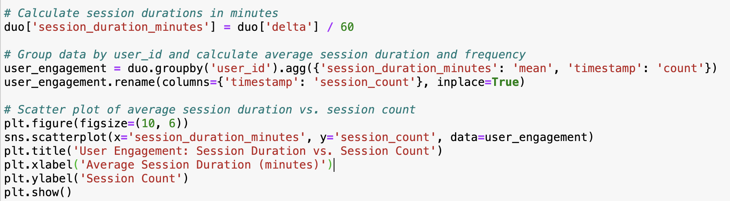
User engagement patterns by frequency and duration of learning sessions.

Slide 16
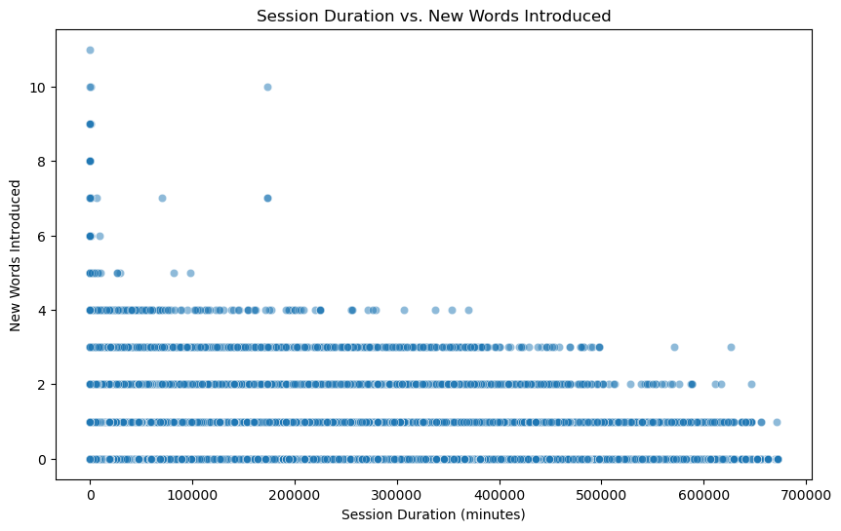
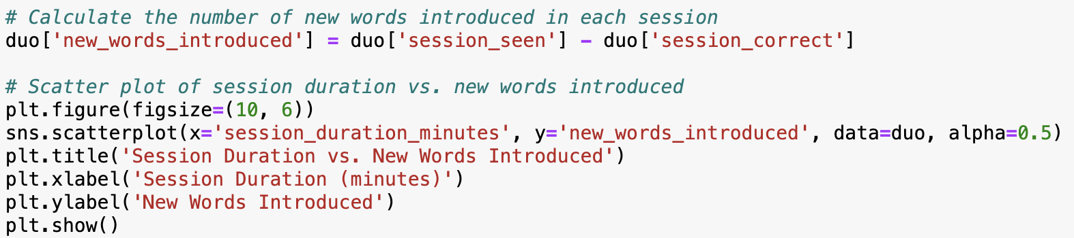
Session Difficulty: whether certain sessions are more challenging based on factors like session duration or the number of new words introduced

Slide 17
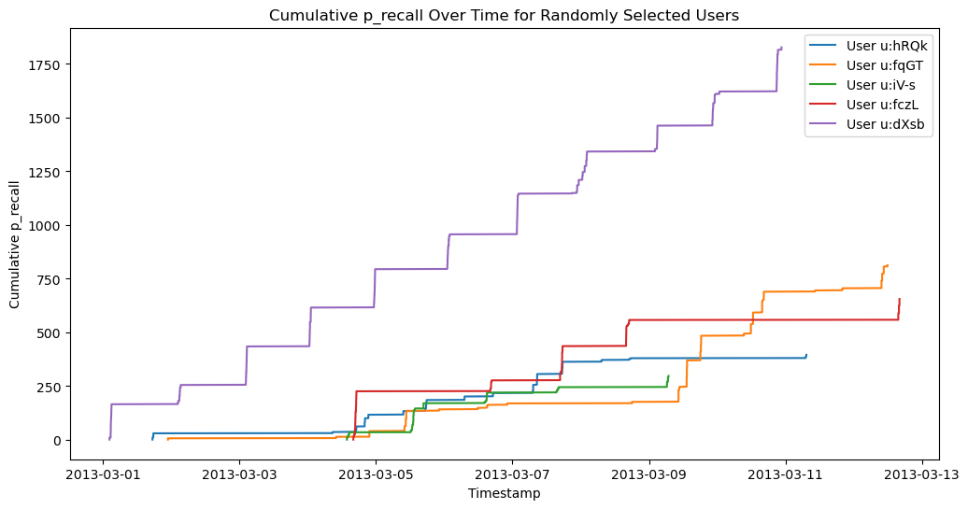
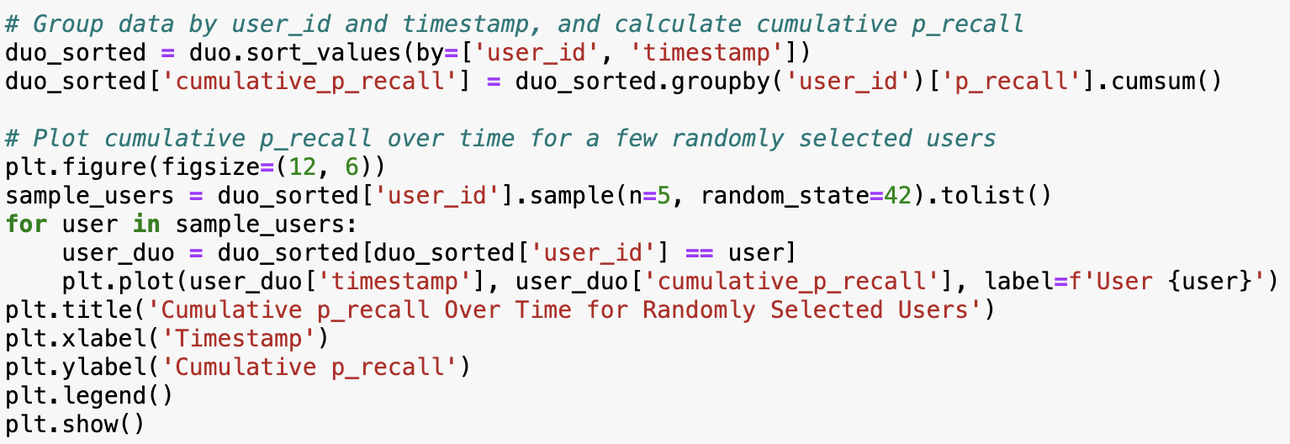
Long-term Learning Trends: How learning outcomes change over time for individual users.

Slide 18
Analysis I am still working on …
Temporal Analysis by Day of Week: Analyze if there are any patterns in learning outcomes based on the day of the week.
Error Analysis: Investigate common errors made by users during learning sessions and identify areas for improvement
Clustering Analysis: Group users based on their learning behavior and performance
Sequential Pattern Mining: Identify common patterns of learning sequences that lead to successful recall.
User Retention Analysis: Analyze user retention by tracking the number of sessions over time.
Word Difficulty Analysis: Investigate the difficulty level of different words based on their recall performance.

Slide 19
02
IMPLICATIONS FOR STAKEHOLDERS
implicaciones para las partes interesadas!

Slide 20
IMPLICATIONS FOR STAKEHOLDERS
Platform Developers
Educators/learners
Research Community
Understanding patterns of user engagement and session effectiveness can guide the development of personalized learning experiences, such as adaptive learning algorithms or targeted content recommendations.
Insights into learning trajectories, proficiency development over time, and common errors made by learners can inform instructional strategies and curriculum design in traditional language learning settings.
Insights from data analysis can inform the development and validation of computational models of language learning, contributing to the broader field of educational technology and cognitive science.

Slide 21
데이터의 윤리적, 법적, 사회적 적용
03
ETHICAL, LEGAL AND SOCIETAL IMPLICATIONS

Slide 22
ETHICAL, LEGAL AND SOCIETAL IMPLICATIONS
Ethics
Legal
Society
Privacy Concerns: The dataset contains user data, including anonymized user IDs. However, even anonymized data can potentially be re-identified, especially when combined with other datasets.
Bias: Analyzing the dataset may reveal biases in the Duolingo platform, such as biased content or assessment methods
Data ownership: Any analysis or findings derived from the dataset should give proper credit to Duolingo.
Date security: Take measures to secure the dataset to prevent unauthorized access or data breaches
Algorithmic Transparency: Ensure transparency and interpretability of these algorithms to understand how they impact users' learning experiences and outcomes.
Understanding how users engage with language learning platforms like Duolingo can have broader societal implications for education, language learning, and technology use. Researchers should consider the potential societal impact of their findings and strive to contribute positively to these areas.

Slide 23
THANK YOU!
Cảm ơn cả nhà iu của kem <3
Comments/feedbacks are appreciated

Slide 24

6,000
Oi!
is the approximate number of languages ​​in the world

